Slide 1
Message Integrity and Message Authentication
Notes:
1

Slide 2
Objectives
❏ To define message integrity
❏ To define message authentication
❏ To distinguish between an MDC and a MAC
❏ To discuss some common MACs
Notes:
2

Slide 3
MESSAGE INTEGRITY
The cryptography systems that we have studied so far provide secrecy, or confidentiality, but not integrity.
However, there are occasions where we may not even need secrecy but instead must have integrity.
Notes:
3

Slide 4
Document and Fingerprint
One way to preserve the integrity of a document is through the use of a fingerprint.
If Alice needs to be sure that the contents of her document will not be changed, she can put her fingerprint at the bottom of the document.
Notes:
4

Slide 5
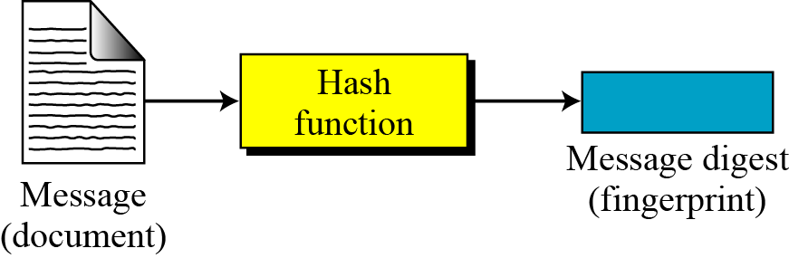
Message and Message Digest
The electronic equivalent of the document and fingerprint pair is the message and digest pair.
Message and digest
Notes:
5

Slide 6
Difference
The two pairs (document / fingerprint) and (message / message digest) are similar, with some differences.
The document and fingerprint are physically linked together. The message and message digest can be unlinked separately.
Most importantly, the message digest needs to be safe from change.
Notes:
6

Slide 7
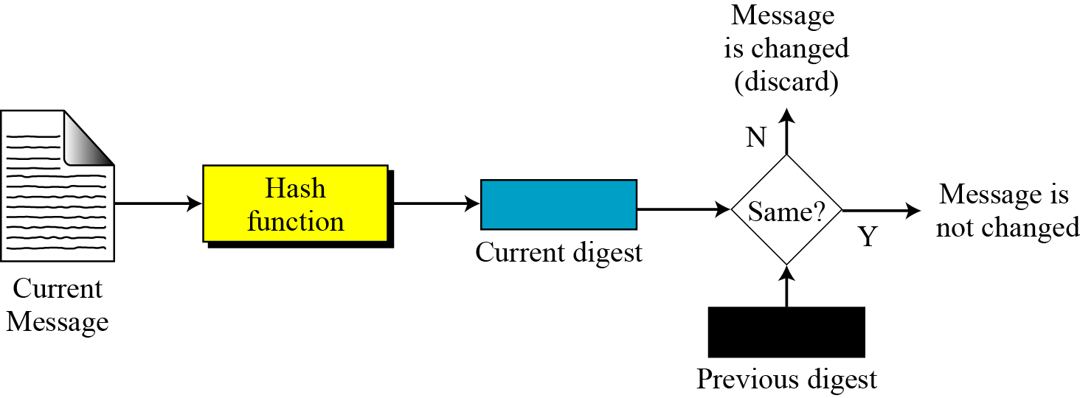
Checking Integrity
Checking integrity
Notes:
7

Slide 8
Message Authentication
message authentication is concerned with:
protecting the integrity of a message
validating identity of originator
non-repudiation of origin (dispute resolution)
will consider the security requirements
then three alternative functions used:
message encryption
message authentication code (MAC)
hash function
Notes:
8
Up till now, have been concerned with protecting message content (ie secrecy) by encrypting the message. Will now consider how to protect message integrity (ie protection from modification), as well as confirming the identity of the sender. Generically this is the problem of message authentication, and in eCommerce applications is arguably more important than secrecy.

Slide 9
Message Authentication Requirements
disclosure
traffic analysis
masquerade
content modification
sequence modification
timing modification
source repudiation
destination repudiation
Notes:
9
In the context of communications across a network, the following attacks can be identified:
1.
Disclosure: Release of message contents to any person or process not possessing the
appropriate cryptographic key.
2.
Traffic analysis: Discovery of the pattern of traffic between parties. In a connection-oriented
application, the frequency and duration of connections could be determined. In either a
connection-oriented or connectionless environment, the number and length of messages between
parties could be determined.
3.
Masquerade: Insertion of messages into the network from a fraudulent source. This includes
the creation of messages by an opponent that are purported to come from an authorized entity.
Also included are fraudulent acknowledgments of message receipt or nonreceipt by someone
other than the message recipient.
4.
Content modification: Changes to the contents of a message, including insertion, deletion,
transposition, and modification.
5.
Sequence modification: Any modification to a sequence of messages between parties,
including insertion, deletion, and reordering.
6.
Timing modification: Delay or replay of messages. In a connection-oriented application, an
entire session or sequence of messages could be a replay of some previous valid session, or
individual messages in the sequence could be delayed or replayed. In a connectionless
application, an individual message (e.g., datagram) could be delayed or replayed.
7.
Source repudiation: Denial of transmission of message by source.
8.
Destination repudiation: Denial of receipt of message by destination.
The first two requirements belong to confidentiality and the remaining requirements belong in the realm of message authentication. At its core this addresses the issue of ensuring that a message comes from the alleged source and has not been altered. It may also address sequencing and timeliness. The use of a digital signature can also address issues of repudiation.

Slide 10
Message Authentication Functions
Message Encryption
Message Authentication Code (MAC)
Hash Function
Notes:
Any message authentication or digital signature mechanism has two levels of functionality. At the lower
level, there must be some sort of function that produces an authenticator: a value to be used to
authenticate a message. This lower-level function is then used as a primitive in a higher-level
authentication protocol that enables a receiver to verify the authenticity of a message.
Types of functions that may be used to produce an authenticator may be grouped into three classes as follows:
Message encryption: The ciphertext of the entire message serves as its authenticator
● Message authentication code (MAC): A function of the message and a secret key that
produces a fixed-length value that serves as the authenticator
● Hash function: A function that maps a message of any length into a fixed-length hash value,
which serves as the authenticator
10

Slide 11
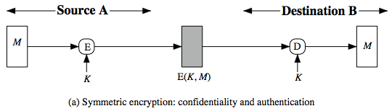
Symmetric Message Encryption
encryption can also provides authentication
if symmetric encryption is used then:
receiver know sender must have created it
…since only sender and receiver know key used
know content are not altered...
... if message has suitable structure, redundancy or a suitable checksum to detect any changes
Notes:
11
11
Message encryption by itself can provide a measure of authentication. The analysis differs for symmetric and public-key encryption schemes.
If use symmetric encryption, If no other party knows the key, then confidentiality is provided. As well, symmetric encryption provides authentication as well as confidentiality, since only the other party can have encrypted a properly constructed message (Stallings Figure 12.1a). Here, the ciphertext of the entire message serves as its authenticator, on the basis that only those who know the appropriate keys could have validly encrypted the message. This is provided you can recognize a valid message (ie if the message has suitable structure such as redundancy or a checksum to detect any changes).

Slide 12
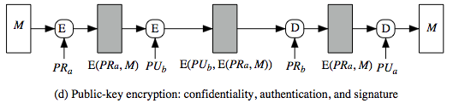
Public-Key Message Encryption
if public-key encryption is used:
encryption provides no confidence of sender
since anyone potentially knows public-key
however if
sender signs message using their private-key
then encrypts with recipients public key
have both secrecy and authentication
again need to recognize corrupted messages
but at cost of two public-key uses on message
Notes:
12
12
With public-key techniques, can use a digital signature which can only have been created by key owner to validate the integrity of the message contents. To provide both confidentiality and authentication, A can encrypt M first using its private key, which provides the digital signature, and then using B's public key, which provides confidentiality (Stallings Figure 12.1d). The disadvantage of this approach is that the public-key algorithm, which is complex, must be exercised four times rather than two in each communication.

Slide 13
MESSAGE AUTHENTICATION CODE (MAC)
A message digest does not authenticate the sender of the message.
To provide message authentication, Alice needs to provide proof that it is Alice sending the message and not an intruder.
The digest created by a cryptographic hash function is normally called a modification detection code (MDC).
What we need for message authentication (data origin authentication) is a message authentication code (MAC).
Notes:
13

Slide 14
Modification Detection Code (MDC)
A modification detection code (MDC) is a message digest that can prove the integrity of the message: that message has not been changed.
If Alice needs to send a message to Bob and be sure that the message will not change during transmission, Alice can create a message digest, MDC, and send both the message and the MDC to Bob.
Bob can create a new MDC from the message and compare the received MDC and the new MDC. If they are the same, the message has not been changed.
Notes:
14

Slide 15
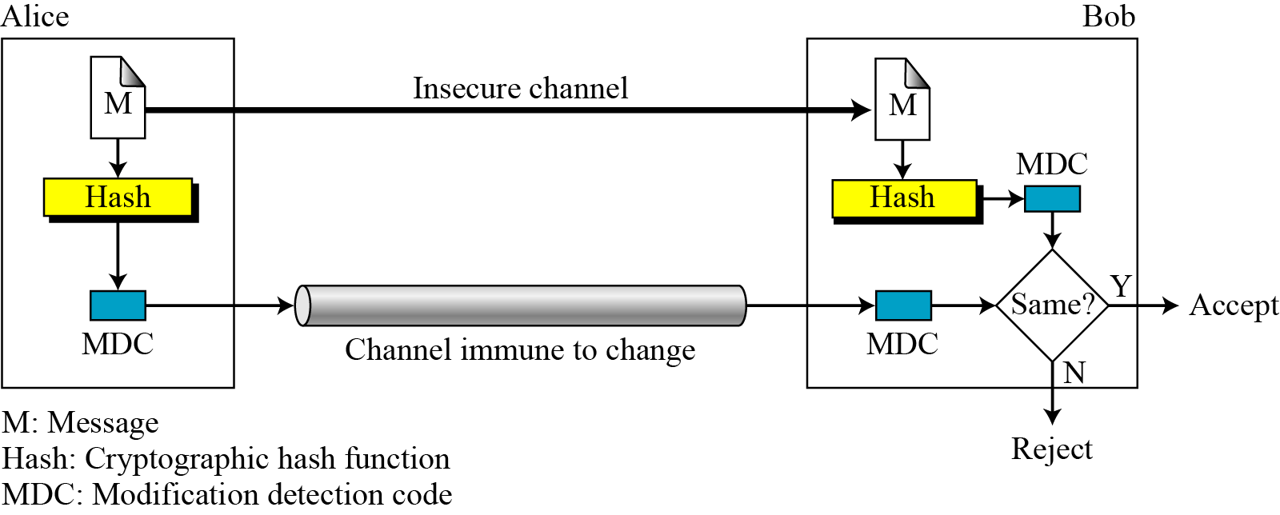
Continued
Modification detection code (MDC)
Notes:
15

Slide 16
Message Authentication Code (MAC)
generated by an algorithm that creates a small fixed-sized block
depending on both message and secret key
like encryption though need not be reversible
appended to message as a “signature”
receiver performs same computation on message and checks it matches the MAC
provides assurance that message is unaltered and comes from sender
Notes:
16
16
An alternative authentication technique involves the use of a secret key to generate a small fixed-size block of data, known as a cryptographic checksum or MAC that is appended to the message. This technique assumes that two communicating parties, say A and B, share a common secret key K. A MAC function is similar to encryption, except that the MAC algorithm need not be reversible, as it must for decryption.

Slide 17
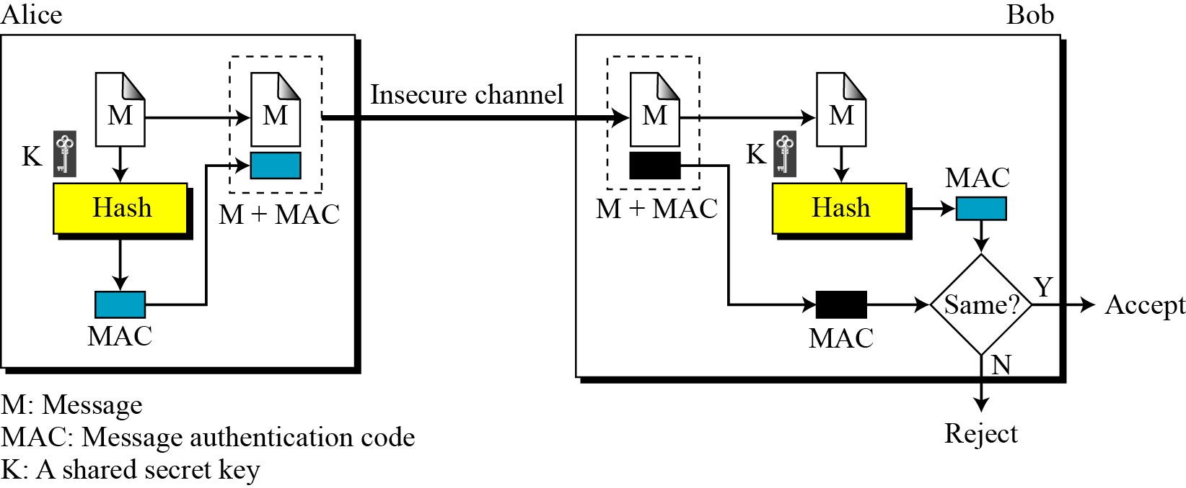

Message Authentication Code (MAC)
Message authentication code
Notes:
17

Slide 18
MAC Properties
a MAC is a cryptographic checksum
MAC = C_{K}(M)
condenses a variable-length message M
using a secret key K
to a fixed-sized authenticator
is a many-to-one function
potentially many messages have same MAC
but finding these needs to be very difficult
Notes:
18
18
A MAC (also known as a cryptographic checksum, fixed-length authenticator, or tag) is generated by a function C. The MAC is appended to the message at the source at a time when the message is assumed or known to be correct. The receiver authenticates that message by re-computing the MAC.
The MAC function is a many-to-one function, since potentially many arbitrarily long messages can be condensed to the same summary value, but don’t want finding them to be easy (see text for discussion)!

Slide 19
Message Authentication Codes
There are three types of MAC:
Prefix MAC: secret key is appended to the beginning of the message.
Postfix MAC: secret key is appended to the end of message.
Combined prefix and postfix MAC: same or two different keys appended to the beginning and end of message
Notes:
19
19

Slide 20
Security of MACs
The security of a MAC depends on the security of the underlying hash algorithm.
Notes:
20
20

Slide 21
Cryptographic Hash Function Criteria
Hash Functions need to satisfy certain properties, which are essential for the hash functions to be secure and useful in various applications.

Slide 22
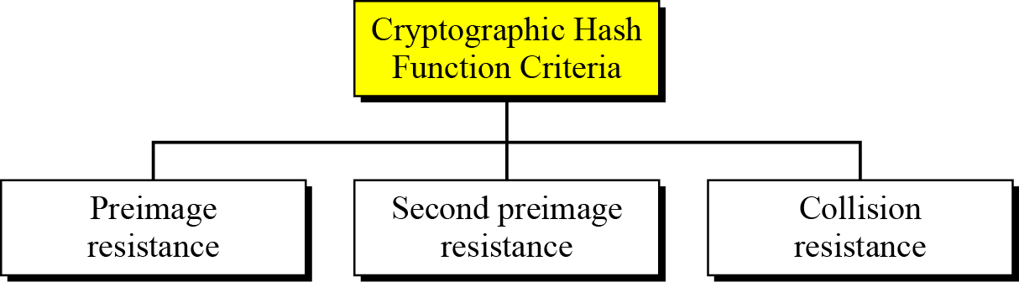
Cryptographic Hash Function Criteria
Criteria of a cryptographic hash function
11.22
Notes:
22

Slide 23
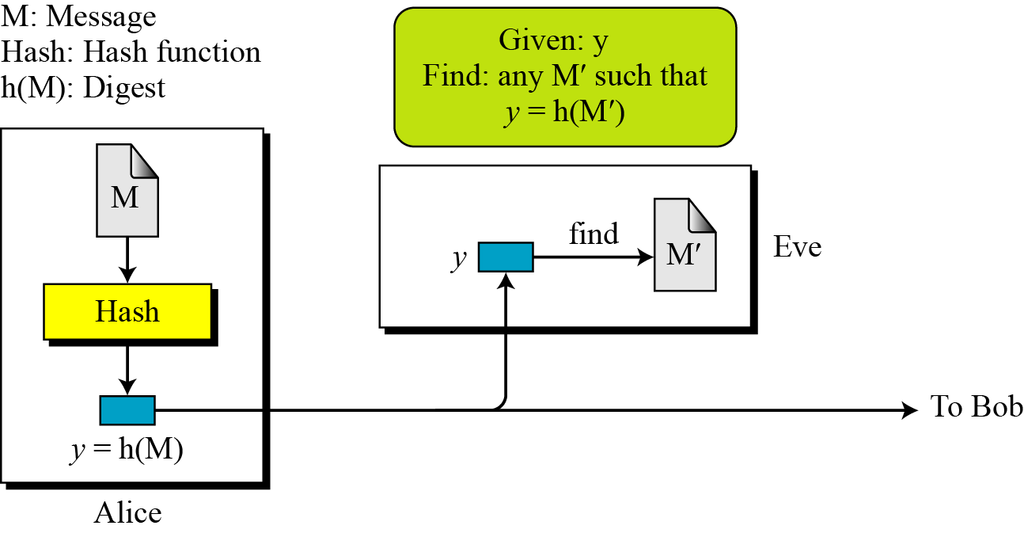
Preimage Resistance
11.23
Notes:
23

Slide 24
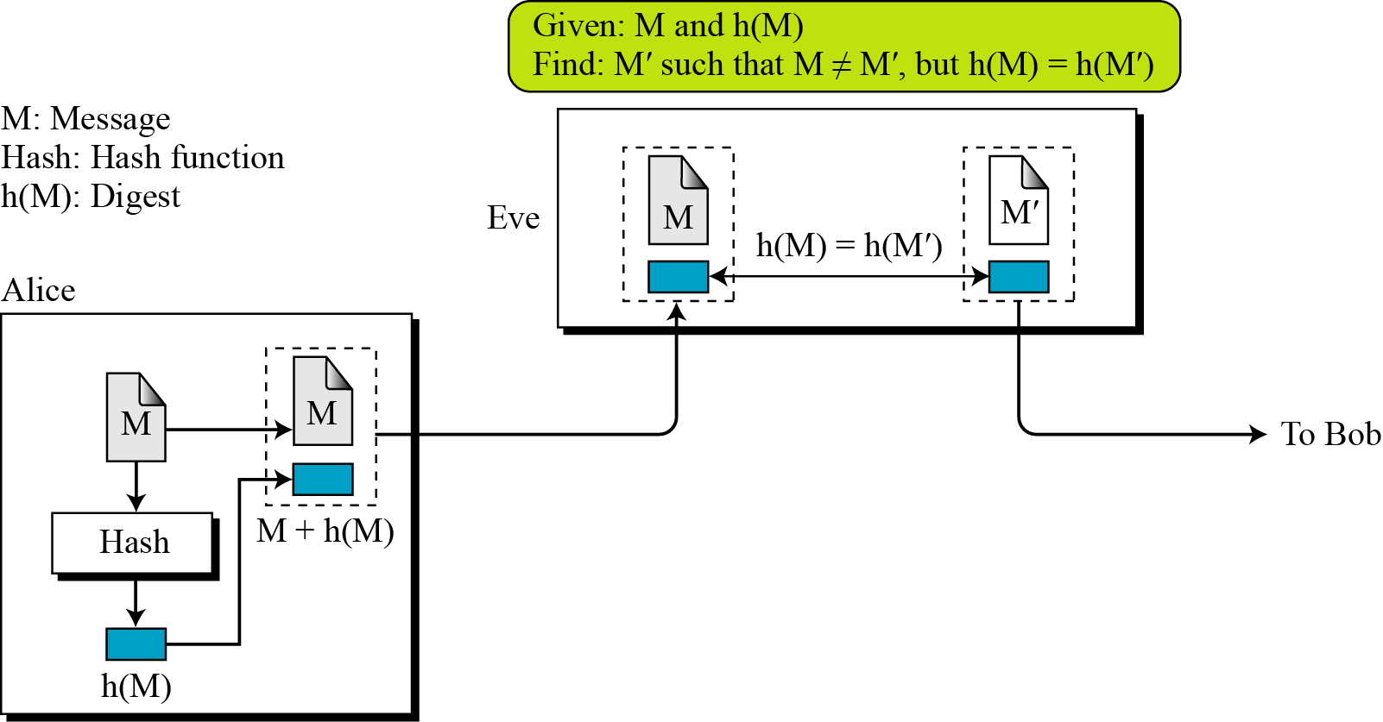
Second Preimage Resistance
11.24
Notes:
24

Slide 25
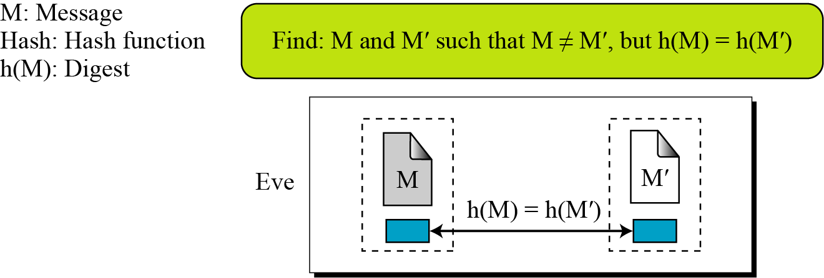
Collision Resistance
11.25
Notes:
25

Slide 26
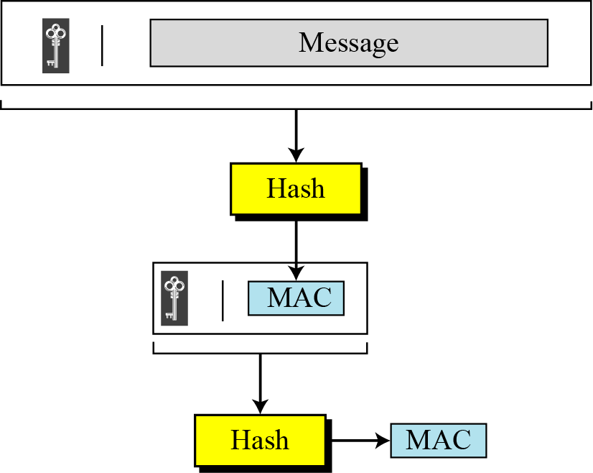
Nested MAC
Nested MAC
Notes:
26

Slide 27
Hashed MAC (HMAC)
NIST has issued a standard (FIPS 198) for nested MAC that is often referred to as HMAC (Hashed MAC)
The implementation of HMAC is much more complex than the simplified nested MAC.
Additional features such as padding

Slide 28
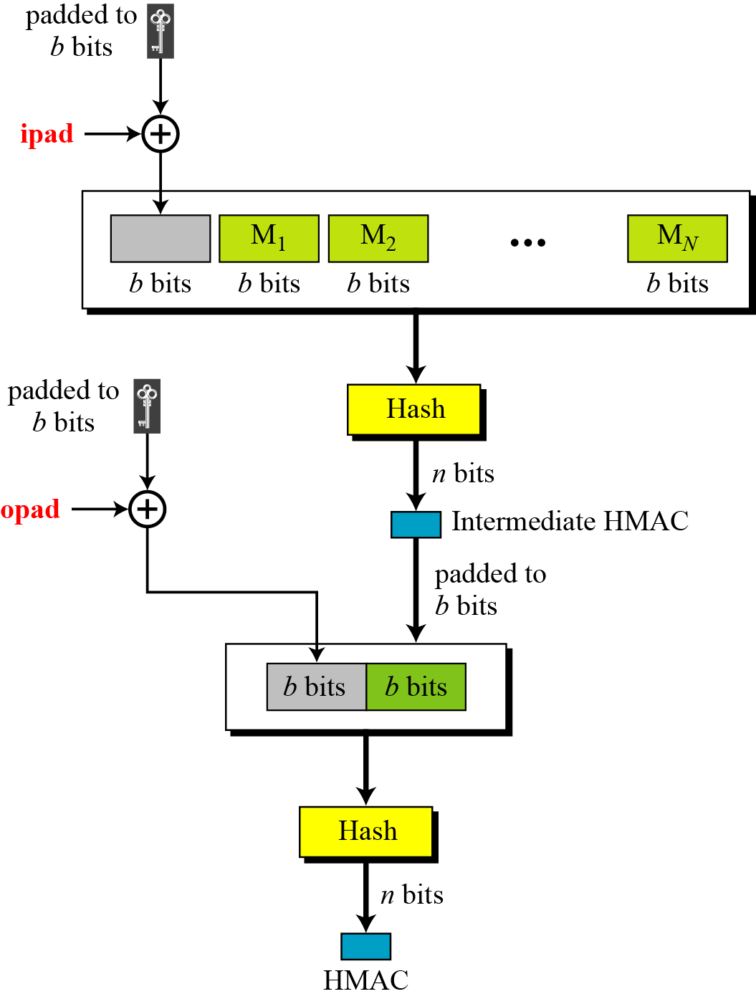
HMAC
Details of HMAC
Notes:
28

Slide 29
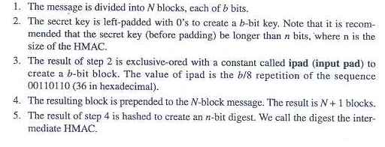
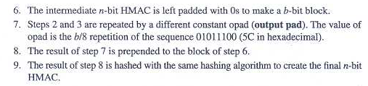

Slide 30
Cipher based MAC (CMAC)
NIST has defined a standard (FIPS 113) called Data Authentication Algorithm (DAA) or CMAC or CBCMAC.
The method is similar to CBC mode of operation of symmetric block cipher.

Slide 31
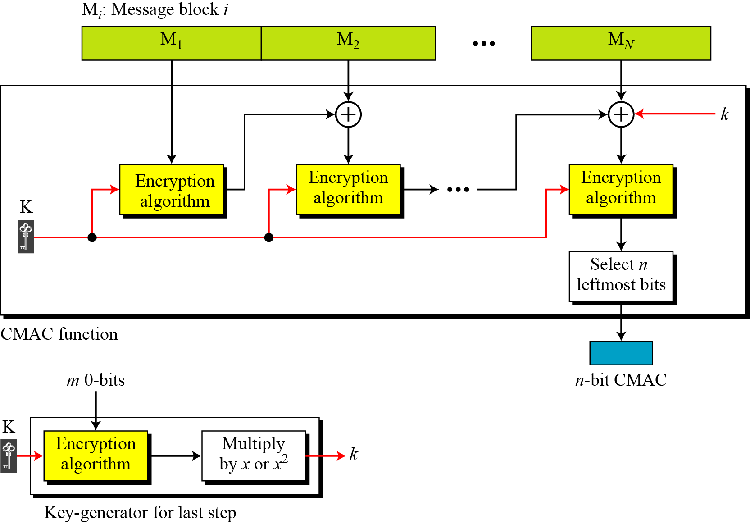
CMAC
Notes:
31

Slide 32
